Slide 1
Docker for Web Developer PART-2
By: Hardik Raval

Slide 2
Quick Recap of Previous Session
What is Docker?
Docker is a open source platform to run and build the application.
Where does Docker run?
It runs natively on natively on Linux, MAC or windows with Docker engine installed by installing Docker Client.
Benefits
Set up development environments in minutes
Application code behaves same as others
Easy Deployment
Docker Terminology
Image, Container, Docker Hub, Docker Client, Docker Daemon/Engine

Slide 3
Commands we have learned so far…
docker pull <image>
Pull the image from docker hub
docker run
docker run php echo “Hey!”
docker run -p 8080:80 -d nginx
docker run -p 8080:80 -v <source>:<destination> nginx
docker ps
Show list of RUNNING containers
docker ps –a
Show all containers
docker stop <container Id>, <container Id>
Stop given container(s)
docker rm <container Id>, <container Id>
Remove given container(s)
docker rm $(docker ps -a -q -f status=exited)
Remove all unused containers
docker container prune
Remove all unused containers
docker rmi <id/name>, <id/name>
Remove given image(s)
docker rmi $(docker images -a -q)
Remove all images

Slide 4
Dockerfile
In general Dockerfile is used to build custom image.
A Dockerfile is a simple text file that contains a list of commands that the Docker client calls while creating an image.
Dockerfile is an alternative of executing commands in command line.

Slide 5
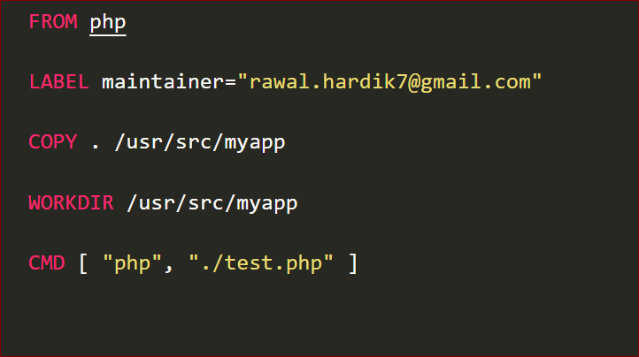
Dockerfile Example #1
Build an custom Image
docker build –t php-app1 .
(don’t forgot the period at the end)
Run an Image
docker run -v ${pwd}:/usr/src/myapp php-app1

Slide 6
Dockerfile Instructions
FROM – Sets a base Image
LABEL – Apply key/value metadata to your images, containers, or daemons.
COPY – Copies new files or directories to container. By default this copies as root
WORKDIR – Sets the working directory
CMD – We can provide default commands for an executing while creating a container.
Reference Link : https://github.com/wsargent/docker-cheat-sheet#dockerfile

Slide 7
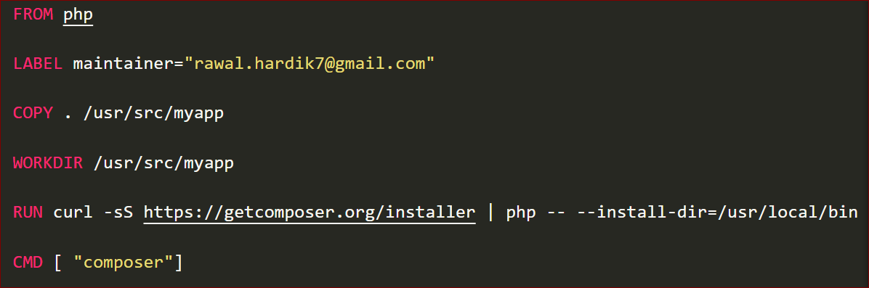
Dockerfile Example #2
docker build -t php-app2 -f app.Dockerfile .

Slide 8
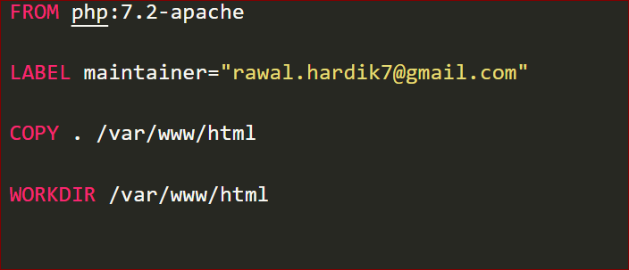
Dockerfile Example #3
docker build -t php-app3 -f php.Dockerfile .
docker run -P php-app3

Slide 9
Run a command in a running container
There are two ways executing commands in running container:
w/o login into the container
docker exec <container Id><cmd>
docker exec 5d8d pwd
w/ login into the container
docker exec -it 5c8a /bin/bash
ls

Slide 10
Other docker commands
docker start <container Id>
Start stopped container
docker restart <container Id>
Restart container
docker inspect <container Id>
Detailed information about specific container
docker run --rm <image>
docker run --rm -p 80:80 nginx
docker cp <container Id> : SRC_PATH DEST_PATH
docker cp index.html 5499:/usr/share/nginx/html/index.html
From host machine to container
docker cp 5499 : /usr/share/nginx/html/index.html index.html
From container to host machine

Slide 11
Stay Tuned!

